Slide 1
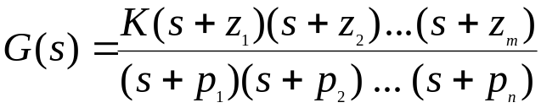
Poles and Zeros and Transfer Functions
Transfer Function:
A transfer function is defined as the ratio of the Laplace
transform of the output to the input with all initial
conditions equal to zero. Transfer functions are defined
only for linear time invariant systems.
Considerations:
Transfer functions can usually be expressed as the ratio
of two polynomials in the complex variable, s.
Factorization:
A transfer function can be factored into the following form.
The roots of the numerator polynomial are called zeros.
The roots of the denominator polynomial are called poles.
wlg

Slide 2
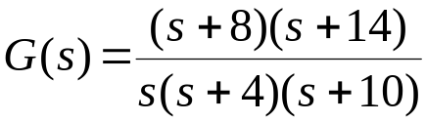
Poles, Zeros and the S-Plane
An Example:
You are given the following transfer function. Show the
poles and zeros in the s-plane.
jω
axis
S - plane
origin
o
x
o
x
x
-14
-10
-8
-4
0
σ axis
wlg

Slide 3
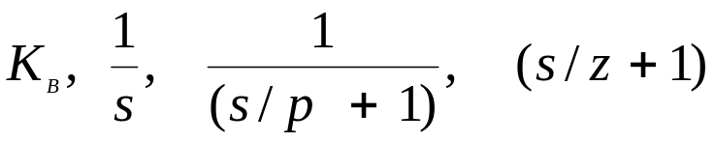
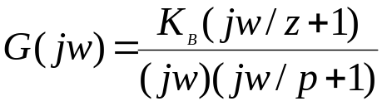
Poles, Zeros and Bode Plots
Characterization:
Considering the transfer function of the
previous slide. We note that we have 4 different
types of terms in the previous general form:
These are:
Expressing in dB:
Given the tranfer function:
wlg

Slide 4
Poles, Zeros and Bode Plots
Mechanics:
We have 4 distinct terms to consider:
20logK_{B}
20log|(jw/z +1)|
-20log|jw|
-20log|(jw/p + 1)|
wlg

Slide 5
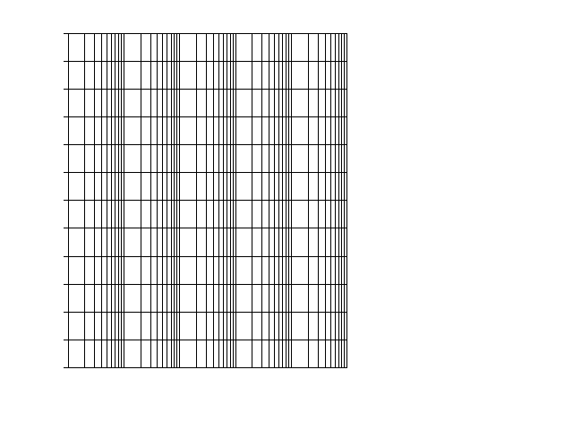
1 1 1 1 1 1
This is a sheet of 5 cycle, semi-log paper.
This is the type of paper usually used for
preparing Bode plots.
dB Mag
Phase
(deg)
wlg
ω (rad/sec)

Slide 6
Poles, Zeros and Bode Plots
Mechanics:
The gain term, 20logK_{B,} is just so many
dB and this is a straight line on Bode paper,
independent of omega (radian frequency).
The term, - 20log|jw| = - 20logw, when plotted
on semi-log paper is a straight line sloping at
20dB/decade. It has a magnitude of 0 at w = 1.
20
-20db/dec
0
-20
ω=1
wlg

Slide 7
Poles, Zeros and Bode Plots
The term, - 20log|(jw/p + 1), is drawn with the
following approximation:
If w < p we use the approximation that –20log|(jw/p + 1 )| = 0 dB,
a flat line on the Bode.
If w > p we use the approximation of –20log(w/p), which slopes at
-20dB/dec starting at w = p.
It is easy to show that the plot has an error of 3dB at w = p and – 1 dB at w = p/2 and w = 2p.One can easily make these corrections if it is appropriate.
20
0
-20db/dec
-20
-40
ω
= p
wlg

Slide 8
Poles, Zeros and Bode Plots
When we have a term of 20log|(jw/z + 1)| we
approximate it be a straight line of slop 0 dB/dec
when w < z. We approximate it as 20log(w/z)
when w > z, which is a straight line on Bode paper
with a slope of + 20dB/dec. Illustrated below.
20
+20db/dec
0
-20
-40
ω
= z
wlg

Slide 9
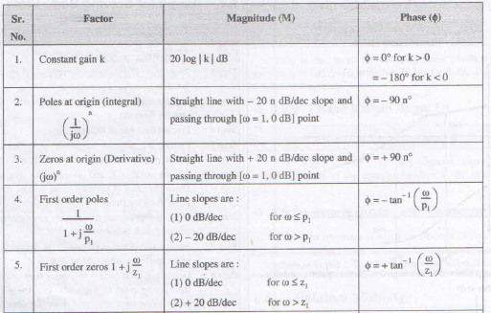

Slide 10
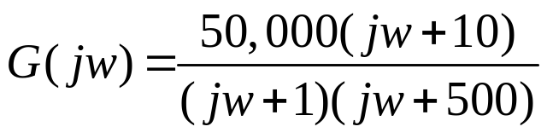
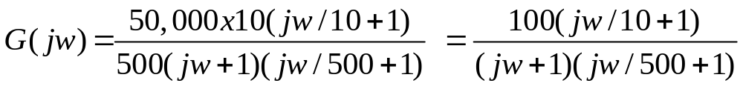
Example 1:
Given:
First: Always get the poles and zeros in a form such that
the constants are associated with the jw terms. In the above example
we do this by factoring out the 10 in the numerator and the 500 in the
denominator.
Second:
When you have neither poles nor zeros at 0, start the Bode
at 20log₁₀K = 20log₁₀100 = 40 dB in this case.
wlg

Slide 11
Example 1:
(continued)
Third: Observe the order in which the poles and zeros occur.
This is the secret of being able to quickly sketch the Bode.
In this example we first have
- a pole at w=1 which causes the Bode to break at 1 and slope – 20 dB/dec.
- Next, a zero at w=10 and this causes a slope of +20 dB/dec which cancels
out the – 20 dB/dec,resulting in a flat line ( 0 db/dec)
. Finally, we have a pole at w = 500 which causes the Bode to slope down
at – 20 dB/dec.
We are now ready to draw the Bode.
Before we draw the Bode we should observe the range
over which the transfer function has active poles and zeros.
This determines the scale we pick for the w (rad/sec)
at the bottom of the Bode.
wlg

Slide 12
Bode Plot Magnitude for 100(1 + jw/10)/(1 + jw/1)(1 + jw/500)
1 1 1 1 1 1
60
1 1 1 1 1 1
4
0
20
dB Mag
Phase (deg)
dB Mag
0
Phase (deg)
-20
-60
-60
ω (rad/sec)
0.1 1 10 100 1000 10000
ω (rad/sec)
wlg

Slide 13
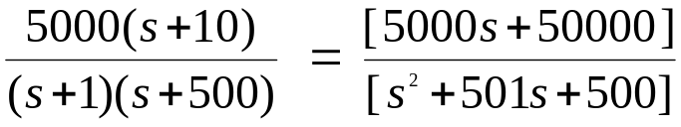
Using Matlab For Frequency Response
Instruction:
We can use Matlab to run the frequency response for
the previous example. We place the transfer function
in the form:
The Matlab Program
num = [5000 50000];
den = [1 501 500];
Bode (num,den)
In the following slide, the resulting magnitude and phase plots (exact)
are shown in light color (blue). The approximate plot for the magnitude
(Bode) is shown in heavy lines (red). We see the 3 dB errors at the
corner frequencies.
wlg

Slide 14
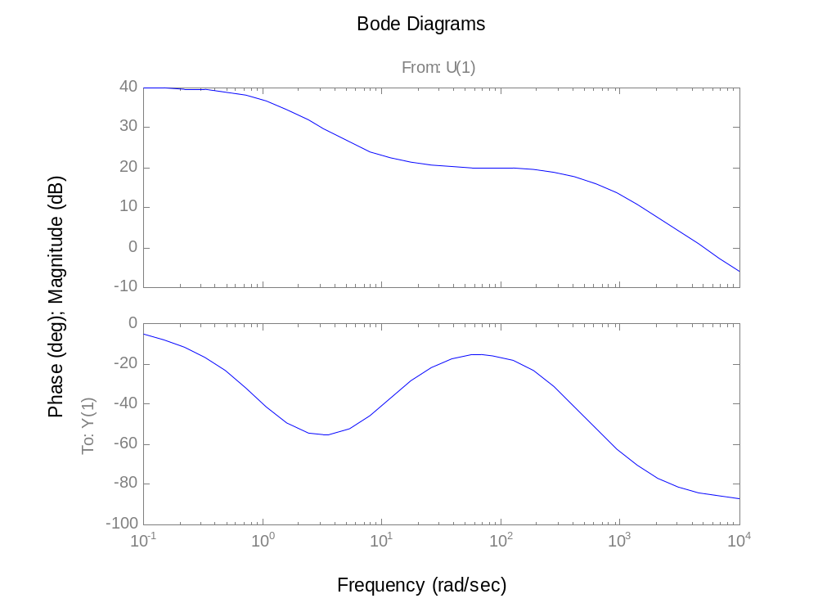
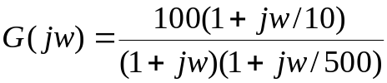
1
10
100
500
Bode for:
wlg

Slide 15
Phase for Bode Plots
Comment:
Generally, the phase for a Bode plot is not as easy to draw
or approximate as the magnitude. In this course we will use
an analytical method for determining the phase if we want to
make a sketch of the phase.
Illustration:
Consider the transfer function of the previous example.
We express the angle as follows:
We are essentially taking the angle of each pole and zero.
Each of these are expressed as the tan⁻¹(j part/real part)
Usually, about 10 to 15 calculations are sufficient to determine
a good idea of what is happening to the phase.
wlg

Slide 16
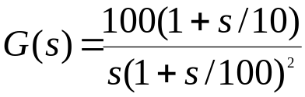

Bode Plots
Example 2:
Given the transfer function. Plot the Bode magnitude.
Consider first only the two terms of
Which, when expressed in dB, are; 20log100 – 20 logw.
This is plotted below.
The
is
40
a tentative line we use
until we encounter the
first pole(s) or zero(s)
not at the origin.
-20db/dec
dB
20
0
-20
wlg
1
ω (rad/sec)

Slide 17
Bode Plots
Example 2:
(continued)
The completed plot is shown below.
60
1 1 1 1 1 1
60
-20db/dec
40
40
20
20
Phase (deg)
dB Mag
-40 db/dec
Phase (deg)
dB Mag
0
0
-20
-20
-40
-40
-60
-60
0.1
0.1
1 10 100 1000
1 10 100 1000
wlg
ω (rad/sec)
ω (rad/sec)

Slide 18
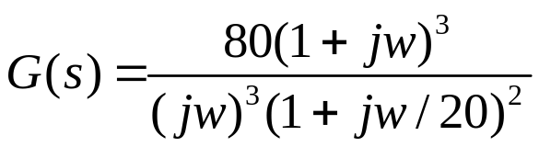
Bode Plots
Example 3:
Given:
20log80 = 38 dB
1 1 1 1 1 1
-60 dB/dec
60
dB Mag
40
-40 dB/dec
20
0
-20
.
0.1
1
10
100
wlg
ω (rad/sec)

Slide 19
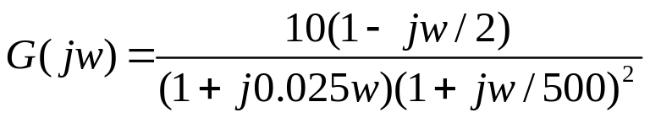
Bode Plots
Example 4:
Given:
1 1 1 1 1 1
60
40
+ 20 dB/dec
20
-40 dB/dec
dB Mag
Phase (deg)
0
-20
Sort of a low
pass filter
-40
-60
0.1
2
1 10 100 1000
wlg
ω (rad/sec)

Slide 20
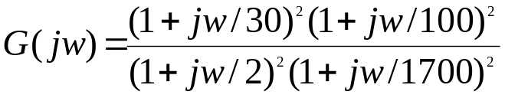
Bode Plots
Given:
Example 5
1 1 1 1 1 1
60
40
20
dB Mag
Phase (deg)
0
-40 dB/dec
Sort of a low
pass filter
-20
+ 40 dB/dec
-40
-60
0.1
1 10 100 1000
wlg
ω (rad/sec)

Slide 21
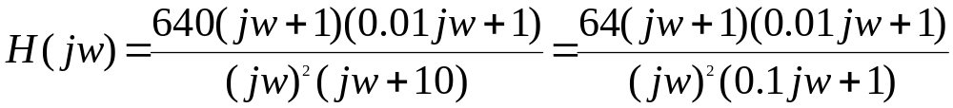
Bode Plots
Given:
problem 11.15 text
Example 6
.
-40dB/dec
40
.
-20db/dec
20
.
-40dB/dec
dB mag
0
-20
.
-20dB/dec
-40
.
0.1 1 10 100 1000
wlg
0.01

Slide 22
Bode Plots
Design Problem:
Design a G(s) that has the following Bode plot.
Example 7
40
30 dB
20
+40 dB/dec
-40dB/dec
0
dB mag
?
?
0.1
1
10
30
100
900
1000
wlg
ω rad/sec

Slide 23
Bode Plots
Procedure:
The two break frequencies need to be found. Recall:
Then we have:
#dec = log₁₀[w₂/w₁]
(#dec)( 40dB/dec) = 30 dB
log₁₀[w₁/30] = 0.75
w₁ = 5.33 rad/sec
Also:
log₁₀[w₂/900]
(-40dB/dec) = - 30dB
This gives w₂ = 5060 rad/sec
wlg

Slide 24
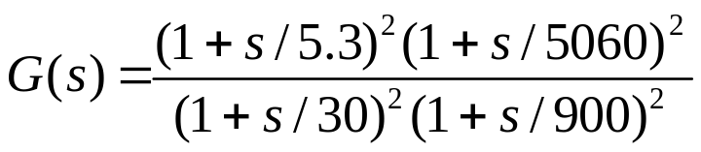
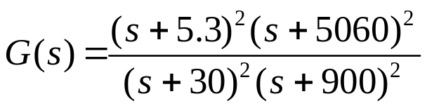
Bode Plots
Procedure:
Clearing:
Use Matlab and conv:
N1 = [1 10.6 28.1] N2 = [1 10120 2.56e+7]
N = conv(N1,N2)
1 1.86e+3 2.58e+7 2.73e+8 7.222e+8
s⁴ s³ s² s¹ s⁰
wlg

Slide 25
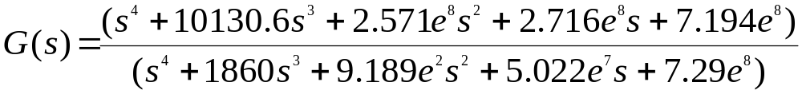
Bode Plots
Procedure:
The final G(s) is given by;
Testing:
We now want to test the filter. We will check it at ω = 5.3 rad/sec
And ω = 164. At ω = 5.3 the filter has a gain of 6 dB or about 2.
At ω = 164 the filter has a gain of 30 dB or about 31.6.
We will check this out using MATLAB and particularly, Simulink.
wlg

Slide 26
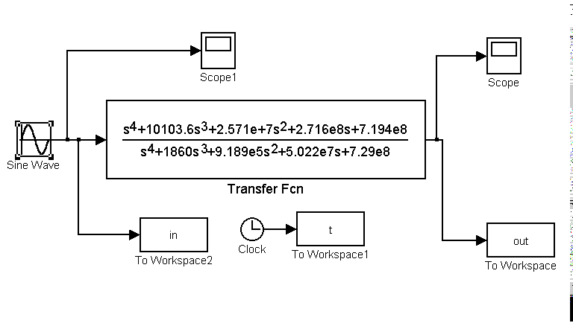
Matlab (Simulink) Model:
wlg

Slide 27
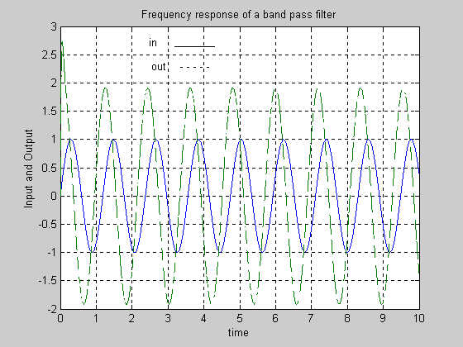
Filter Output at ω = 5.3 rad/sec
Produced from Matlab Simulink
wlg

Slide 28
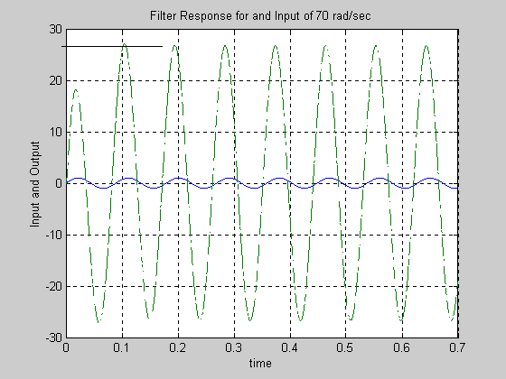
Filter Output at ω = 70 rad/sec
Produced from Matlab Simulink
wlg

Slide 29
Reverse Bode Plot
Required:
From the partial Bode diagram, determine the transfer function
(Assume a minimum phase system)
Example 8
Not to scale
68
20 db/dec
-20 db/dec
30
20 db/dec
dB
1
ω
110
850
wlg

Slide 30
Reverse Bode Plot
Required:
From the partial Bode diagram, determine the transfer function
(Assume a minimum phase system)
Example 9
100 dB
-40 dB/dec
Not to scale
50 dB
-20 dB/dec
-20 dB/dec
10 dB
-40 dB/dec
0.5
40
300
wlg
w (rad/sec)

Slide 31
Stability Analysis using Bode Plots
From the Bode plots, we can say whether the control system is stable, marginally stable or unstable based on the values of these parameters.
Gain cross over frequency and phase cross over frequency
Gain margin and phase margin

Slide 32
Phase Cross over Frequency &Gain Cross over Frequency
The frequency at which the phase plot is having the phase of -180⁰ is known as phase cross over frequency. It is denoted by ωpc. The unit of phase cross over frequency is rad/sec.
The frequency at which the magnitude plot is having the magnitude of zero dB is known as gain cross over frequency. It is denoted by ωgc. The unit of gain cross over frequency is rad/sec.

Slide 33
The stability of the control system based on the relation between the phase cross over frequency and the gain cross over frequency is listed below.
If the phase cross over frequency ωpc is greater than the gain cross over frequency ωgc, then the control system is stable.
If the phase cross over frequency ωpc is equal to the gain cross over frequency ωgc, then the control system is marginally stable.
If the phase cross over frequency ωpc is less than the gain cross over frequency ωgc, then the control system is unstable.

Slide 34
Gain Margin
Gain margin GM is equal to negative of the magnitude in dB at phase cross over frequency.
GM=20log(1Mpc)=20logMpc
Where, Mpc is the magnitude at phase cross over frequency. The unit of gain margin (GM) is dB.

Slide 35
Phase Margin
The formula for phase margin PM is
PM=180ͦ +ϕgc
Where, ϕgc is the phase angle at gain cross over frequency. The unit of phase margin is degrees.

Slide 36
The stability of the control system based on the relation between gain margin and phase margin is listed below.
If both the gain margin GM and the phase margin PM are positive, then the control system is stable.
If both the gain margin GM and the phase margin PM are equal to zero, then the control system is marginally stable.
If the gain margin GM and / or the phase margin PM are/is negative, then the control system is unstable.

Slide 37
Gain and Phase Margin
Let's say that we have the following system:
where K is a variable (constant) gain and G(s) is the plant under consideration.
The gain margin is defined as the change in open loop gain required to make the system unstable. Systems with greater gain margins can withstand greater changes in system parameters before becoming unstable in closed loop. Keep in mind that unity gain in magnitude is equal to a gain of zero in dB.
The phase margin is defined as the change in open loop phase shift required to make a closed loop system unstable.
The phase margin is the difference in phase between the phase curve and -180 deg at the point corresponding to the frequency that gives us a gain of 0dB (the gain cross over frequency, Wgc).
Likewise, the gain margin is the difference between the magnitude curve and 0dB at the point corresponding to the frequency that gives us a phase of -180 deg (the phase cross over frequency, Wpc).

Slide 38
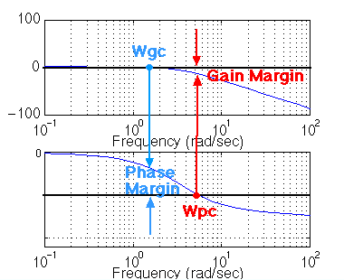
Gain and Phase Margin

Slide 39

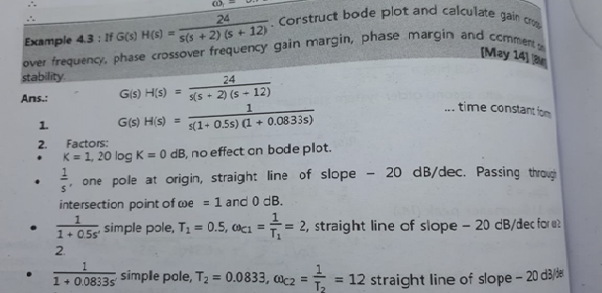

Slide 40
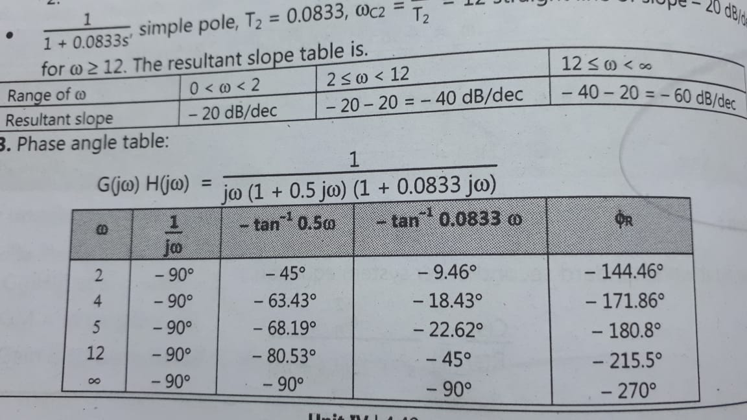

Slide 41
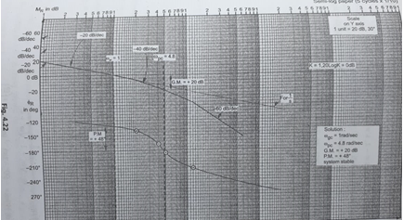

Slide 42
Polar plot
Polar plot is a plot to be drawn between magnitude and phase. But the magnitudes are presented with normal values only.
The polar form ofG(jω)H(jω)is
G(jω)H(jω)=|G(jω)H(jω)|∠G(jω)H(jω)
The Polar plot is a plot, which can be drawn between the magnitude and the phase angle ofG(jω)H(jω)by differentiating g ωfrom zero to ∞. The polar graph sheet is described in below mentioned image.

Slide 43
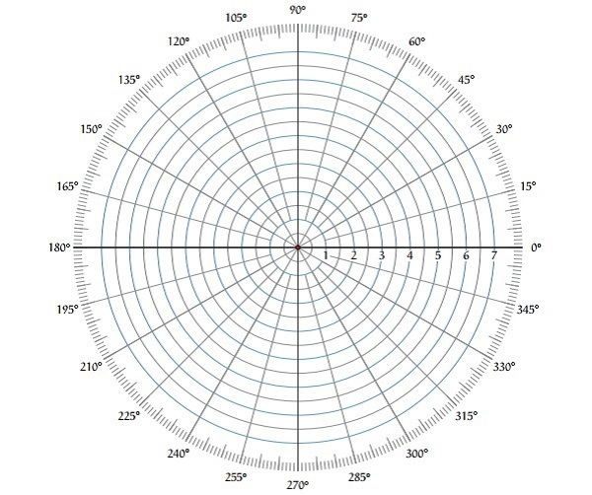

Slide 44
This graph sheet includes various concentric circles and radial lines. The concentric circles and the radial lines are considered as the magnitudes and phase angles. These angles are highlighted with positive values in anti-clock wise direction. So that, we can mark angles with negative values in clockwise direction. Let’s see this example where the angle270⁰in anti-clock wise direction is equal to the angle−90⁰in clockwise direction.

Slide 45
Rules for Drawing Polar Plots
Below mentioned rules are used for plotting the polar plots.
Substitute, s=jω in the open loop transfer function.
Write the expressions for magnitude and the phase of G(jω)H(jω).
Find the starting magnitude and the phase of G(jω)H(jω) by substituting ω=0. So, the polar plot starts with this magnitude and the phase angle.
Find the ending magnitude and the phase of G(jω)H(jω)by substituting ω=∞. So, the polar plot ends with this magnitude and the phase angle.
Check whether the polar plot intersects the real axis, by making the imaginary term of G(jω)H(jω) equal to zero and find the value(s) of ω.
Check whether the polar plot intersects the imaginary axis, by making real term of G(jω)H(jω) equal to zero and find the value(s) of ω.
For drawing polar plot more clearly, find the magnitude and phase of G(jω)H(jω)by considering the other value(s) of ω.

Slide 46
Example
Consider the open loop transfer function of a closed loop controlSystem. G(s)H(s)=5s(s+1)(s+2)G(s)H(s)=5s(s+1)(s+2) Let us draw the polar plot for this control system using the above rules.
Step 1 − Substitute, s=jω in the open loop transfer function.
G(jω)H(jω)=5jω(jω+1)(jω+2)G(jω)H(jω)=5jω(jω+1)(jω+2)
The magnitude of the open loop transfer function is
M=5ω(√ω2+1)(√ω2+4)M=5ω(ω2+1)(ω2+4)
The phase angle of the open loop transfer function is
ϕ=−900−tan−1ω−tan−1ω2ϕ=−900−tan−1⁡ω−tan−1⁡ω2
Step 2 − The following table shows the magnitude and the phase angle of the open loop transfer function at ω=0ω=0 rad/sec and ω=∞ω=∞ rad/sec.

Slide 47
Frequency (rad/sec) Magnitude Phase angle(degrees)
0 ∞ -90 or 270
∞ 0 -270 or 90
While the polar plot starts at (∞,−900) and ends at (0,−2700). The first and the second terms includes in the brackets which shows the magnitude and phase angle.
Step 3 – As per the starting and the ending polar shows that this polar plot will follows the negative real axis. The phase angle related to the negative real axis is−1800or1800. Once you equate the phase angle of the open loop transfer function to either−1800or1800, we will get the ω value as √2.
Once you change the CSPPin the magnitude of the open loop transfer function, we will receive we M=0.83M=0.83. So that the polar plot intersects the negative real axis when
ω = √ 2
and the polar coordinate is (0.83,−1800).
It shows that we can draw the polar plot with the above information on the polar graph sheet.

